Slide 1
CIS CONTROL 12: BOUNDARY DEFENSE - II
BOUNDARY DEFENSE

Slide 2
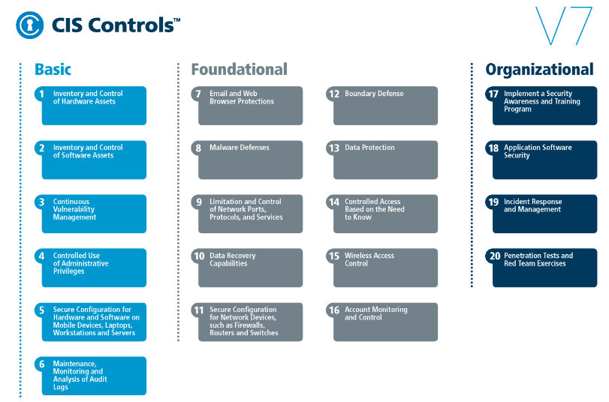
CIS CONTROL 12: BOUNDARY DEFENSE - II
https://www.cisecurity.org/controls/

Slide 3
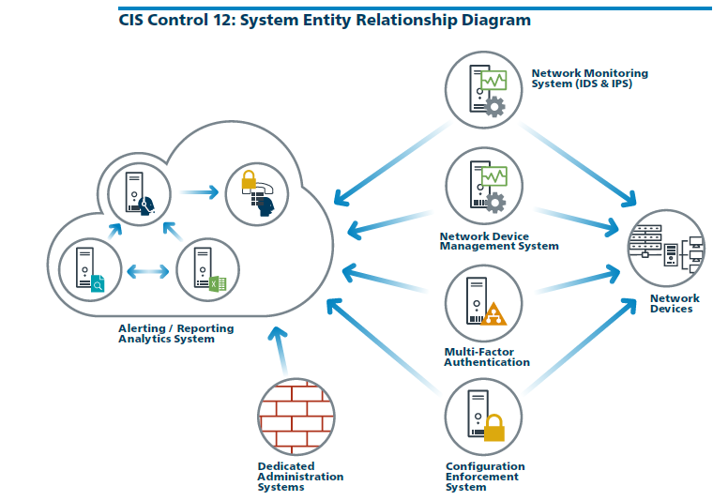
CIS CONTROL 12: BOUNDARY DEFENSE - II
https://www.cisecurity.org/controls/

Slide 4
CIS CONTROL 12: BOUNDARY DEFENSE - II
12.5: Configure Monitoring Systems to Record Network Packets
Configure monitoring systems to record network packets passing through the boundary at each of the organization's network boundaries.

Slide 5
CIS CONTROL 12: BOUNDARY DEFENSE - II
12.6: Deploy Network-based IDS Sensor
Deploy network-based Intrusion Detection Systems (IDS) sensors to look for unusual attack mechanisms and detect compromise of these systems at each of the organization's network boundaries.

Slide 6
CIS CONTROL 12: BOUNDARY DEFENSE - II
12.7: Deploy Network-Based Intrusion Prevention Systems
Deploy network-based Intrusion Prevention Systems (IPS) to block malicious network traffic at each of the organization's network boundaries.

Slide 7
CIS CONTROL 12: BOUNDARY DEFENSE - II
12.8: Deploy NetFlow Collection on Networking Boundary Devices
Enable the collection of NetFlow and logging data on all network boundary devices.
END

